Slide 1
Website Traffic Analysis
Task 2
Objective: Website Traffic Analysis Company: Alfido Tech
Tech Stack: PowerPoint

Slide 2

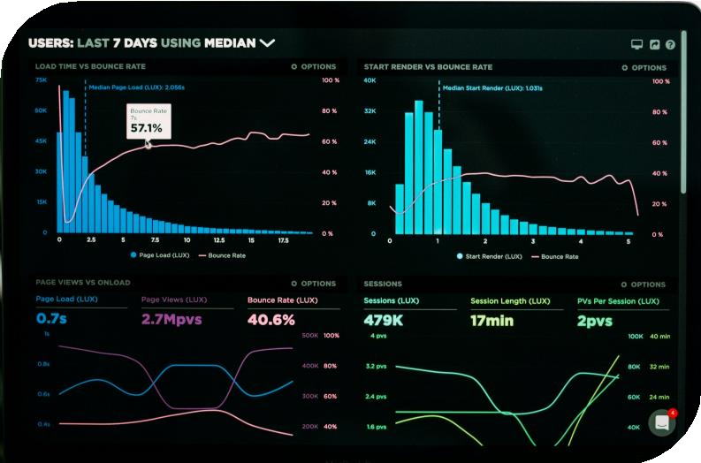

01
Overview

Slide 3

Introduction
This project focuses on analyzing website traffic to understand user behavior, key traffic sources, and overall site performance. By studying metrics such as Clicks, Previews and bounce rate, the analysis provides actionable insights to improve user experience, optimize marketing strategies, and drive growth.

Slide 4
Problem Statement
The company has a functional online presence, but limited understanding of how visitors interact with its website. Without detailed insights into traffic sources, user engagement, and conversion patterns, the company faces challenges in optimizing marketing strategies, improving user experience, and maximizing ROI from digital efforts.

Slide 5
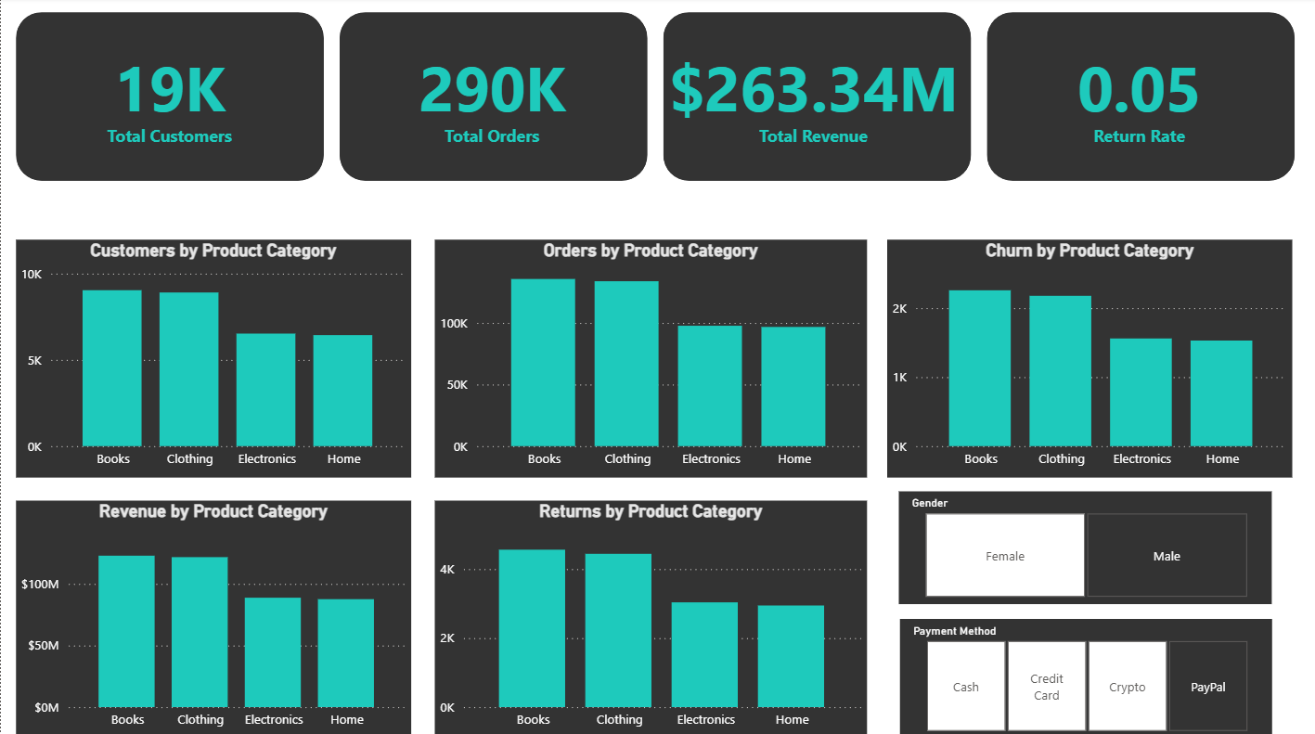
Dashboard Overview

Slide 6

02
Data Cleaning

Slide 7
Data Cleaning Techniques Used
To ensure accuracy and reliability in the analysis, several data cleaning techniques were applied. The Power Query Editor was used to split the datetime column, retaining only the date for consistency in time-based analysis. Column names were standardized to maintain uniformity across the dataset. Duplicate records were checked and removed to prevent skewed results. Blank spaces were identified and eliminated to improve data quality. Additionally, entries marked as "unknown" in the city column were removed to ensure the dataset only reflected valid and meaningful information.

Slide 8

03
Data Visualisation

Slide 9
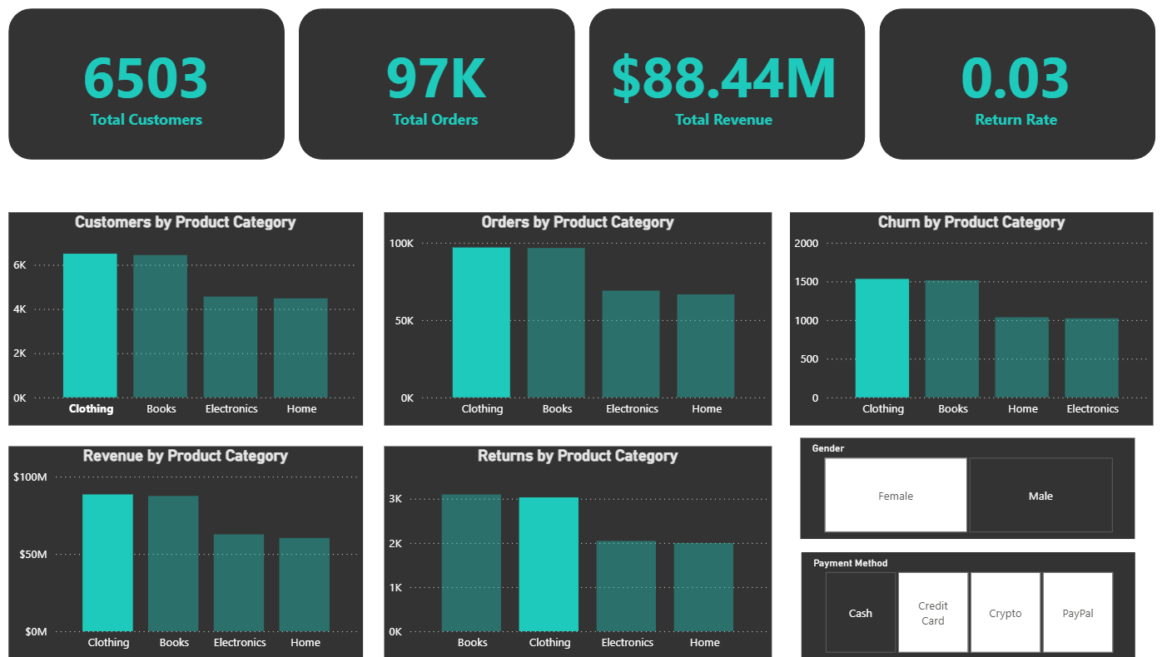
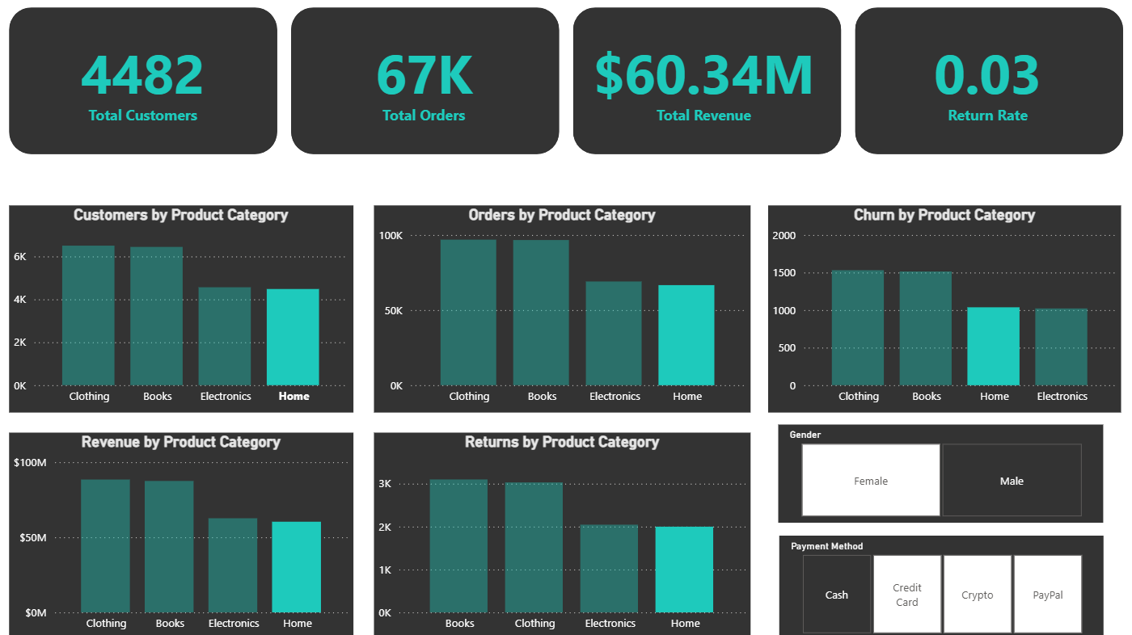
Visual 1: Clothing, Home(Female)

Slide 10
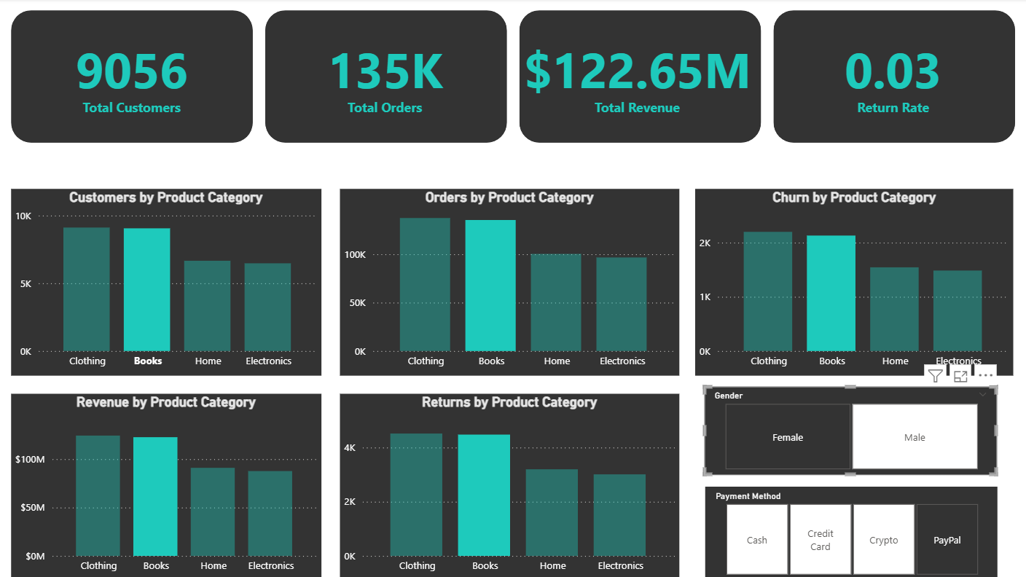
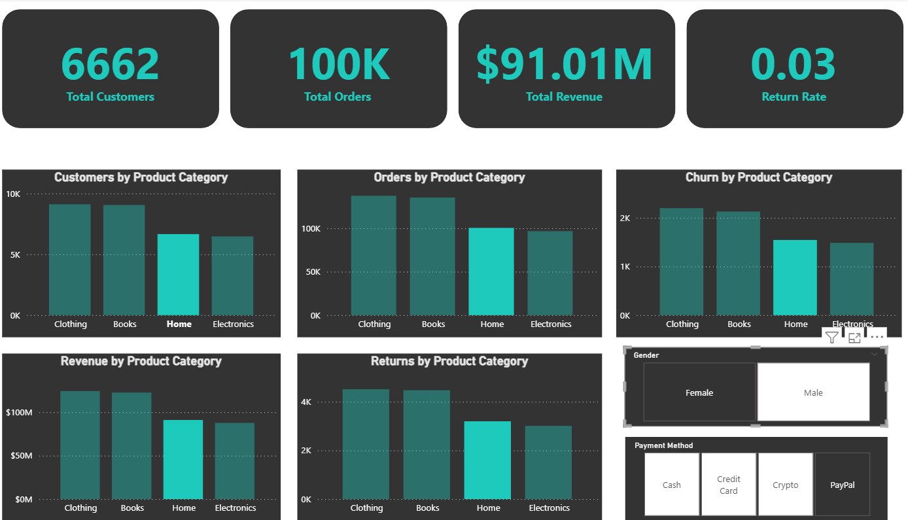
Visual 2: Books, Electronics(Male)

Slide 11
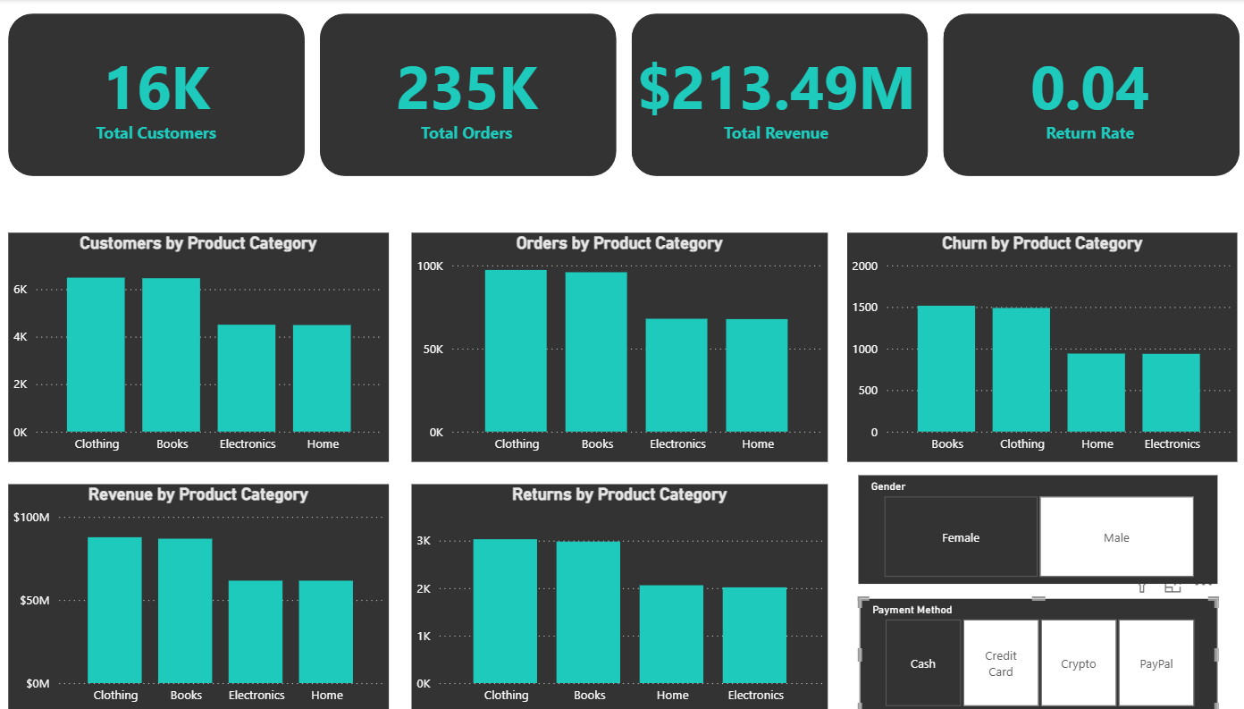
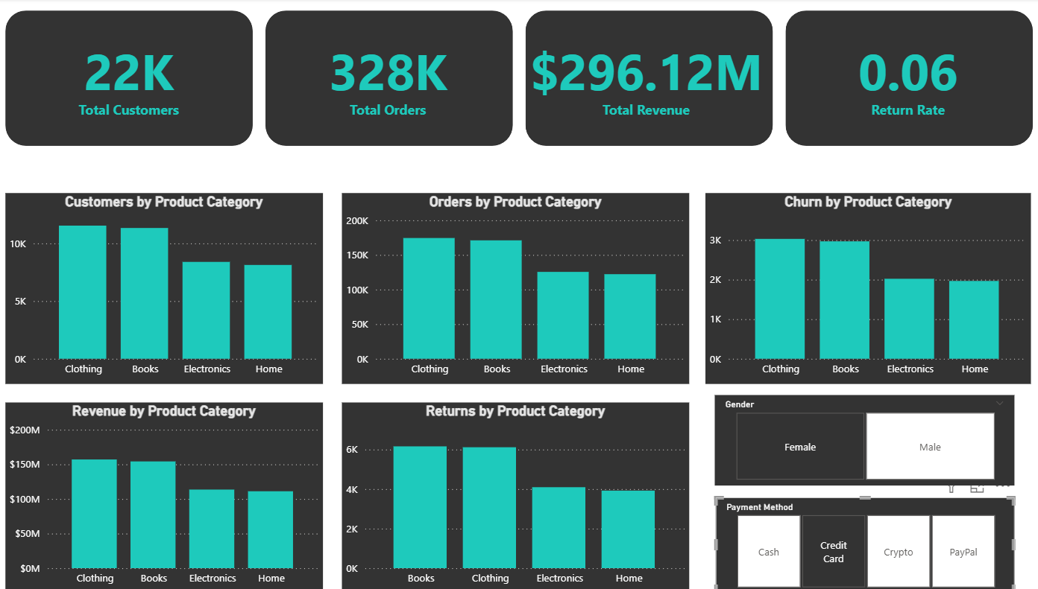
Visual 3: Payment Methods

Slide 12
04
Key Insights and Recommendations

Slide 13

Key Insights Gained
The analysis shows India, Saudi Arabia, and the US drive the most clicks, with Jeddah and Riyadh leading among cities. Tesher dominates global and subcontinent engagement, far ahead of other artists. Website traffic stayed stable with a slight dip mid-period, and pageviews form the largest share of engagement, followed by clicks and previews.

Slide 14
Recommendations for Decision Makers
Decision makers should focus on strengthening presence in high- traffic regions like India, Saudi Arabia, and the US, while also targeting cities such as Jeddah, Riyadh, and Hyderabad for localized campaigns. Since pageviews dominate engagement but clicks are lower, strategies should aim at improving conversion through optimized content, CTAs, and personalized recommendations. Highlighting popular artists like Tesher can further boost user engagement, while diversifying promotions across other emerging artists may help capture wider audiences. Continuous monitoring of traffic dips will ensure timely interventions to maintain steady growth.

Slide 15



Thank you!
Do you have any questions?
Connect on Socials.

